Slide 1
Types of Sentences
Jeopardy Review Game
Notes:
Put together by Brenna Johnson 12-03-2010

Slide 2
Meanings
Identify
End
Games
Recognize
Me?
Hodge
Podge
$1
$1
$1
$1
$1
$2
$2
$2
$2
$2
$5
$5
$5
$5
$5
$10
$10
$10
$10
$10
$20
$20
$20
$20
$20

Slide 3
It ends with a period.

Slide 4
What is a declarative sentence?

Slide 5
It ends with a question mark.

Slide 6
What is an interrogative sentence?

Slide 7
I am an emotional outburst.

Slide 8

What is an exclamatory sentence?

Slide 9
I am a command.

Slide 10
What is an imperative sentence?

Slide 11
I can end with either a period or exclamation mark.

Slide 12
What is an imperative sentence?

Slide 13
Identify the following sentence.
The dog walked to the park without its master.

Slide 14
What is a declarative sentence?

Slide 15
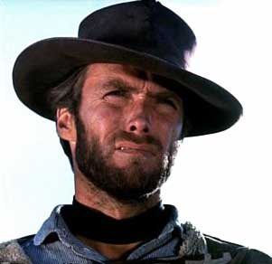
Identify the following sentence.
Are you feeling lucky today, punk?
Notes:
http://www.google.com/imgres?imgurl=http://henrysheehan.com/essays/def/eastwood.jpg&imgrefurl=http://henrysheehan.com/essays/def/eastwood.html&usg=__D0qCjlrW2F8s5hQOUTA_CK4jUss=&h=292&w=301&sz=10&hl=en&start=0&zoom=1&tbnid=lNf7rsi2CY6vQM:&tbnh=124&tbnw=128&prev=/images%3Fq%3DClint%2BEastwood%26um%3D1%26hl%3Den%26sa%3DN%26rls%3Dcom.microsoft:en-us:IE-SearchBox%26biw%3D1419%26bih%3D680%26tbs%3Disch:1&um=1&itbs=1&iact=hc&vpx=239&vpy=197&dur=1457&hovh=221&hovw=228&tx=157&ty=133&ei=rLD5TLNHgqCUB9rzyaUH&oei=krD5TKjYH8G88gbvvKXuBw&esq=4&page=1&ndsp=29&ved=1t:429,r:1,s:0

Slide 16
What is interrogative?

Slide 17
Identify the following sentence.
That car is out of control!

Slide 18
What is exclamatory?

Slide 19

Identify the following sentence.
Feed Earl the piranha his supper.

Slide 20
What is an imperative sentence?

Slide 21

Identify the following sentence.
Frogs are warty, green, and have buggy eyes.

Slide 22
What is a declarative sentence?

Slide 23
What punctuation mark should this sentence have?
Jamie and Adam star in the television program Mythbusters on the Discovery Channel; they are always putting science to the test

Slide 24
What is a period?

Slide 25
Identify the punctuation mark should this sentence have.
Did you take your shower yet

Slide 26

What is a question mark?

Slide 27
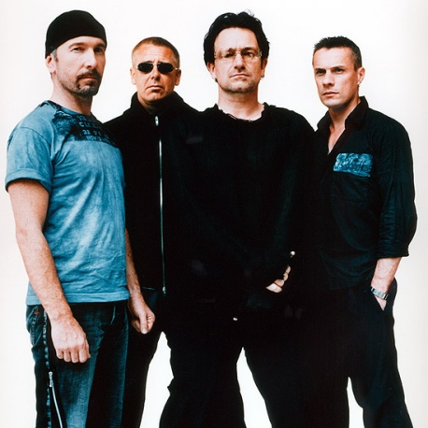
Identify the punctuation mark should this sentence have.
Listen to this new song by U2

Slide 28
What is a period?

Slide 29
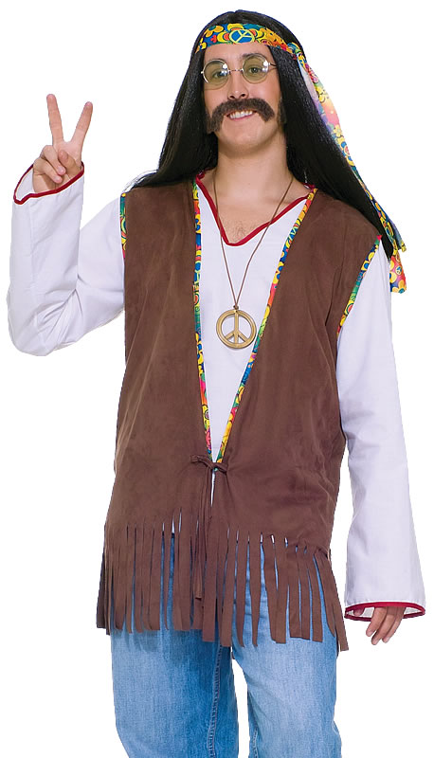
Identify the punctuation mark this sentence should have.
No way, dude

Slide 30

What is an exclamation mark?

Slide 31
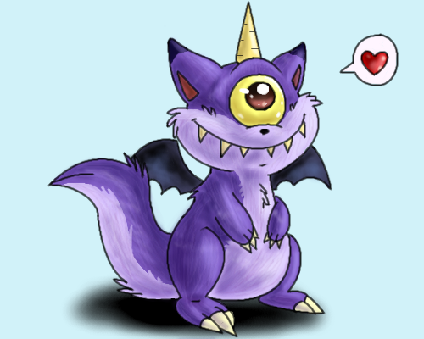
Identify the punctuation this sentence should have.
One eyed, one-horned flying purple people eaters are attacking the city of
New York right now

Slide 32
What is an exclamation mark?
Don’t you think it’s time to RUN?

Slide 33

I am the bossy sentence.

Slide 34
What is an imperative sentence?

Slide 35

I am always asking questions like your parents.

Slide 36
What is an interrogative sentence?

Slide 37


I am the type of sentence you usually see in a lot of the reading you do.

Slide 38
What is a declarative sentence?

Slide 39
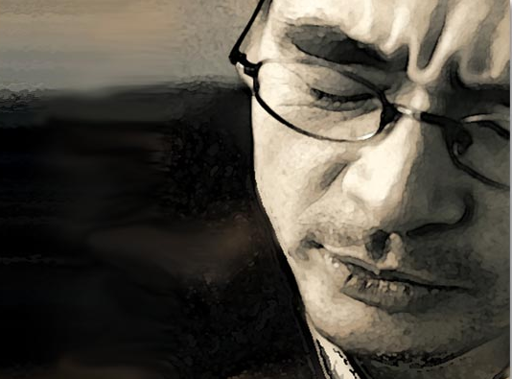
I am not used very often because I’m an emotional type of sentence.
Notes:
http://www.oralcancerfoundation.org/emotional/images/emotional_index.jpg

Slide 40
What is exclamatory?

Slide 41
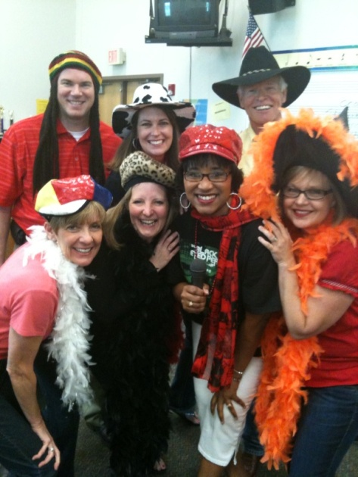
Run for your life!
Mrs. Johnson is right behind you.

Slide 42
What are exclamatory and declarative sentences and some great advice to heed if you’re up to no good?

Slide 43
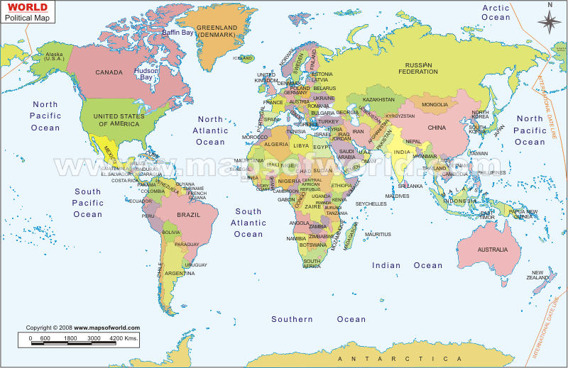
How is it done?
If Mrs. Johnson wants to know where you live.
http://studentweb.cencol.ca/wtsang15/COMP%20213/Midterm/world-map.gif
Notes:
Source of map: http://studentweb.cencol.ca/wtsang15/COMP%20213/Midterm/world-map.gif

Slide 44
What is an interrogative sentence?

Slide 45

How is it done?
If Mrs. Johnson says, “Sit down now.”

Slide 46
What is an imperative sentence?

Slide 47
How is it done?
I want to convey information.

Slide 48
What is a declarative sentence?

Slide 49
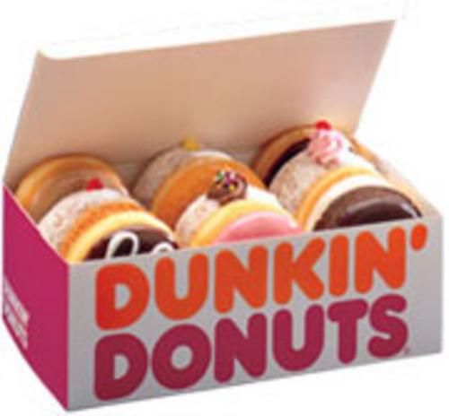
How is it done?
I want to tell someone directions on visiting the local Dunkin Donuts in Walmart.

Slide 50
What is an imperative sentence?

Slide 51
How is it done?
When I want to make a request on my favorite radio station, Jack FM?

Slide 52

What is an interrogative sentence?

Slide 53

Final Jeopardy Answer
Identify the following sentences in the paragraph below. The punctuation is missing, but spelling and capitalization are correct.
Who says cake is bad for you Cake is nutritious It has wheat, eggs, and milk You can drink a glass of fruit juice along side it and still meet those pesky daily requirements I mean why should we bother with oatmeal and pancakes when cake is in the house Rise up and ask for cake, ladies and gentlemen When you try to persuade your parents, become historical and quote a royal princess “Let them eat cake ” “How beautiful you look, Mom” She may let you have a piece after that

Slide 54
Who says cake is bad for you? (Int.) Cake is nutritious. (Dec.) It has wheat, eggs, and milk. (Dec.) You can drink a glass of fruit juice along side it and still meet those pesky daily requirements. (Dec.) I mean why should we bother with oatmeal and pancakes when cake is in the house? (Int.) Rise up and ask for cake, ladies and gentlemen! (Imp.) When you try to persuade your parents, become historical and quote a royal princess. (Imp.) “Let them eat cake!” (Imp.)
“How beautiful you look, Mom!” (Exc.) She may let you have a piece after that. (Dec.)
Do not try this at home!

